Slide 1
UNIT 4 Human
Biology
Chapter 12–
Evolutionary Trends
In Hominids

Slide 2
EVOLUTION OF THE HUMAN SPECIES
Humans have same basic characteristics as the great apes and together they are classified in the family Hominidae. (the hominids)
.
Chimpanzees, gorillas and humans are separated from orang-utans are placed in the subfamily Homininae (the hominines)
The tribe Hominini (hominins) is used to distinguish humans and our extinct ancestors from gorillas, chimpanzees and their extinct ancestors.
See next slide two slides for classification of all primates and more specifically apes and humans

Slide 3
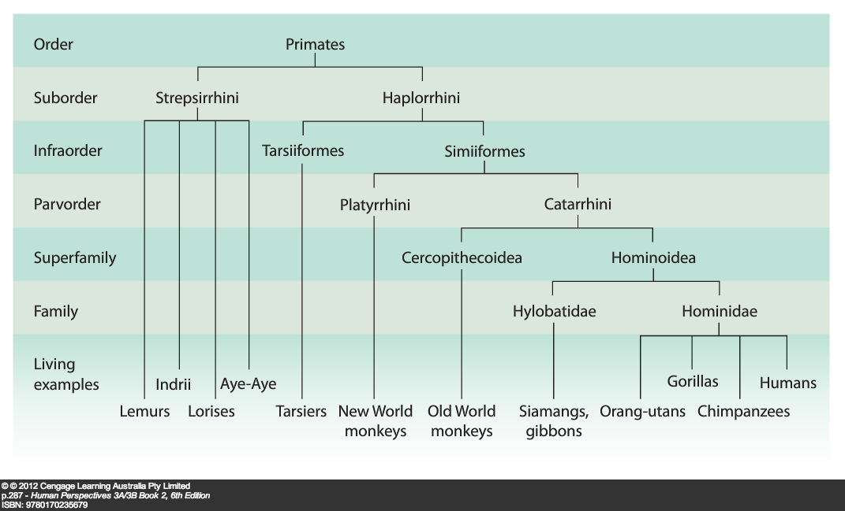

Slide 4

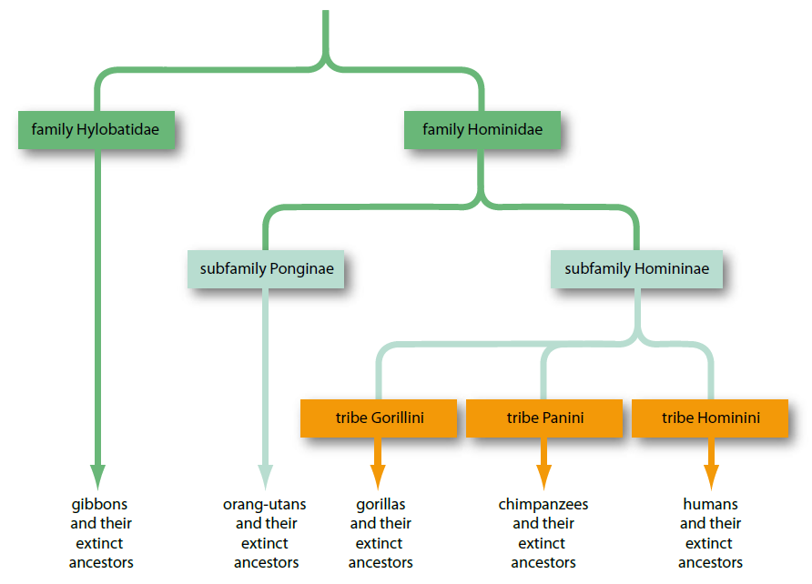

Slide 5
Evolutionary trends in hominids
Human ancestors
Apes and humans share a common ancestor, an ape-like creature. From that ancestral ape the first hominins evolved. These were the australopithecines – Tribe Hominini classified in the genus Australopithecus. From one or more of the australopithecine species evolved early members of the genus Homo. Species of early Homo gradually evolved into a number of different species, including Homo erectus and Homo neanderthalensis, and eventually into modern humans, Homo sapiens.
ADAPTATIONS FOR AN ERECT POSTURE
To make it possible for humans to stand on two legs, and to walk bipedally with a striding gait, changes have evolved in the skeleton and muscles. (See next slide)
An adaptation is any characteristic that helps an organism to survive and reproduce in its natural environment. Erect posture helped human ancestors to survive.

Slide 6
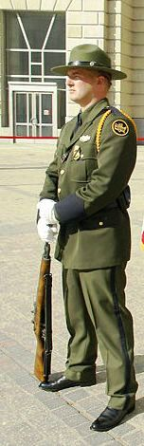
Upright bipedalism basic principles
In order to stand upright our centre of balance has to fall within the area described by our feet.
By standing ‘at-ease’, this soldier has lowered his centre of gravity and increased the base area described by his feet. This stance is very stable.

Slide 7
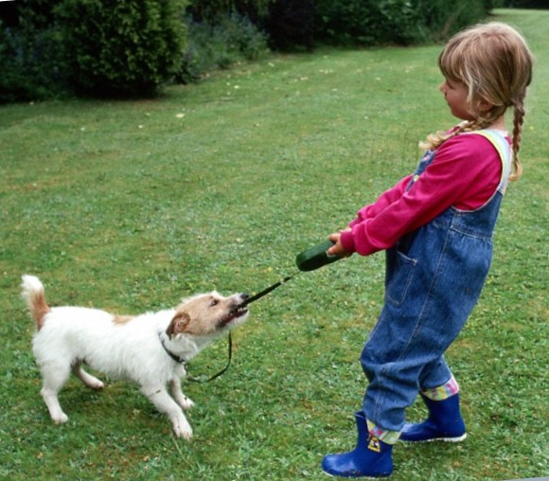
Despite having her feet apart this girl will fall over if she lets go of the leash; however, the dog won’t.
Anthea Sieveking, Wellcome Images

Slide 8

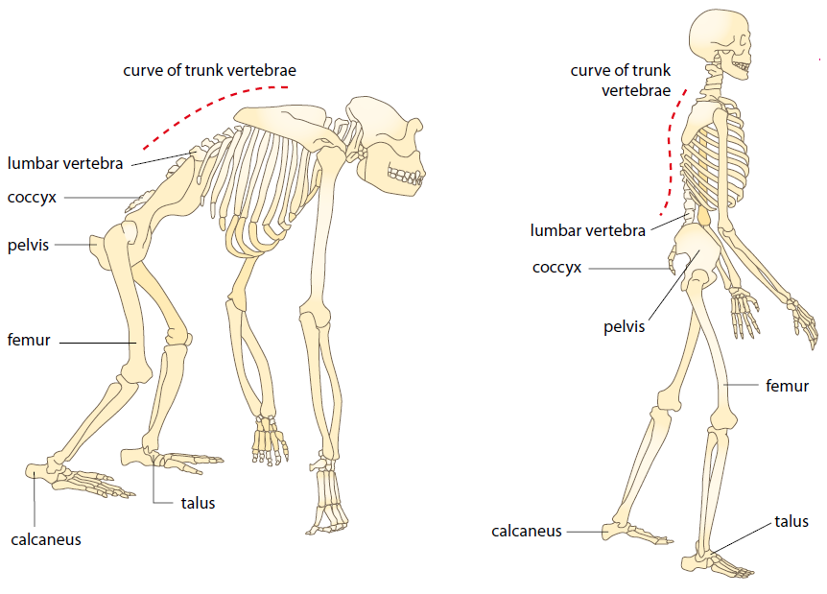

Slide 9
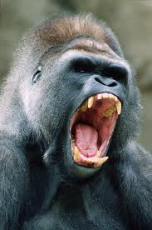
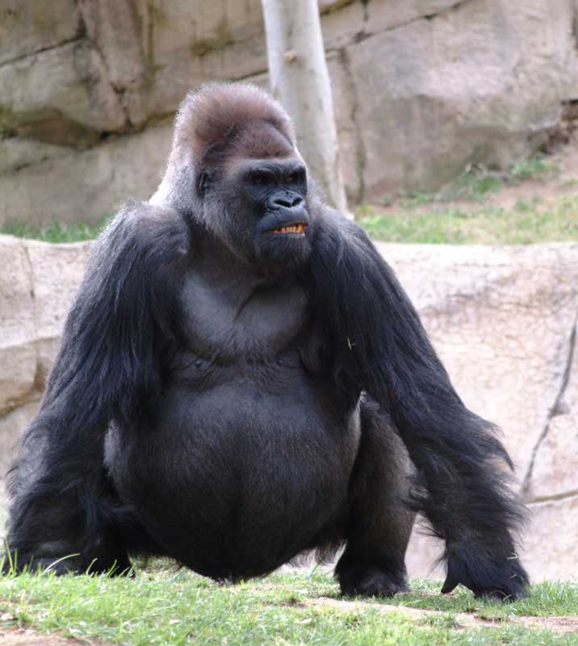
1. Position of the foramen magnum
Where the brain joins on to the spinal cord there is a hole in the skull called the foramen magnum – In humans located centrally underneath the skull - in quadrupeds towards the back of the skull.
During evolution, the foramen magnum has gradually moved forward until the skull is able to balance on top of vertebral column. A gorilla needs large neck muscles to hold head in position (See next slide). In humans weight borne by vertebral column so that large neck muscles are not required.
http://klb.uwstout.edu/GorillaYawning01_2.gif&t=1
http://www.wildabouttheworld.com/gallery/data/505/Gorilla.jpg

Slide 10
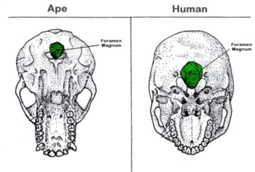
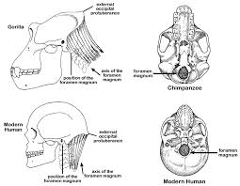
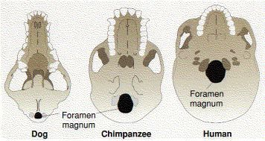
Position of foramen magnum

Slide 11
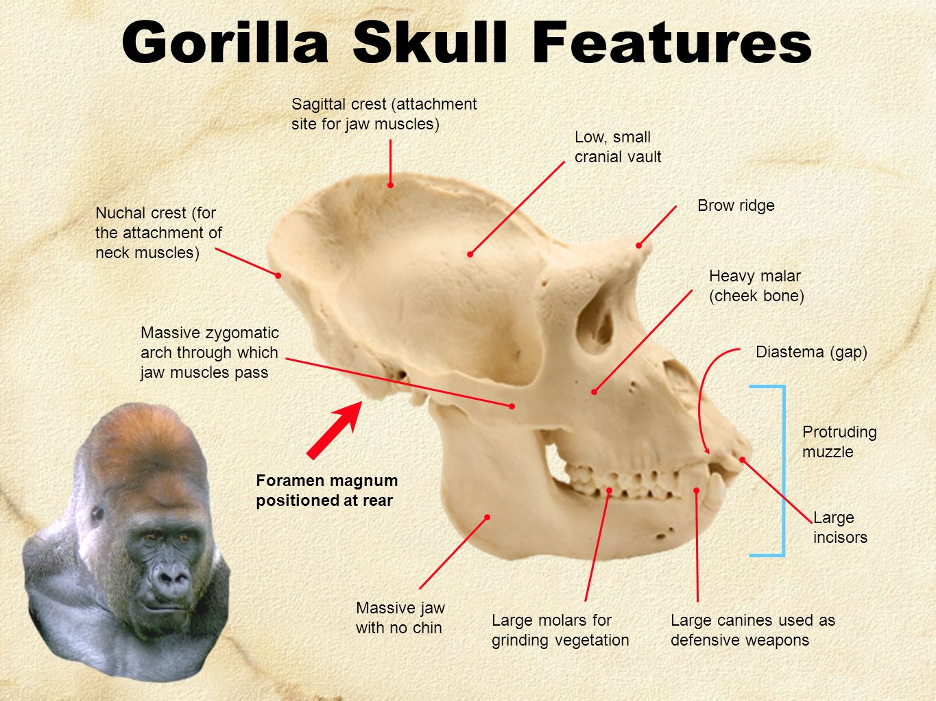
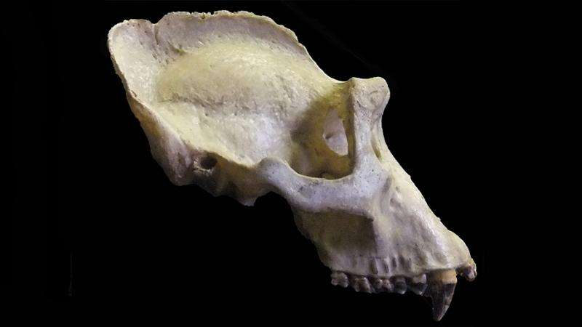
Sagittal crest in gorilla skull

Slide 12
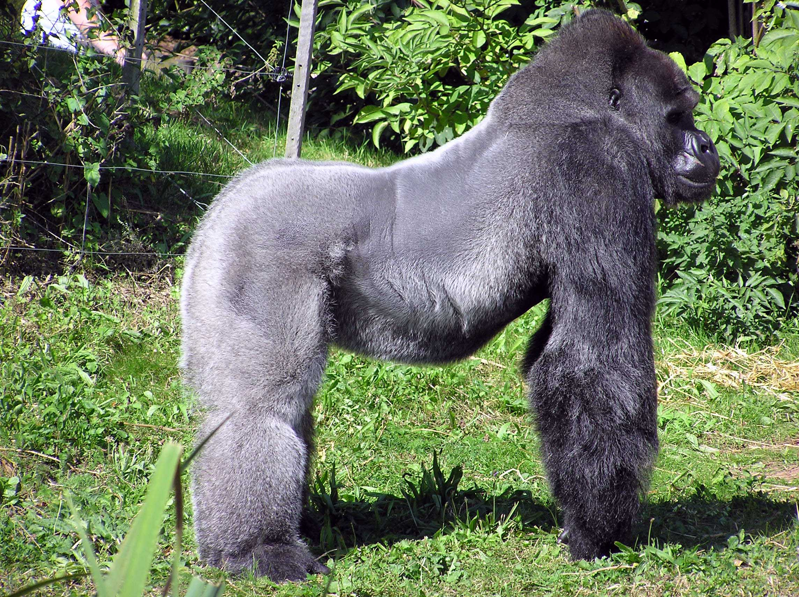
http://en.academic.ru/pictures/enwiki/66/Bristol.zoo.western.lowland.gorilla.arp.jpg

Slide 13
2. Curvature of the spinal column (See next slide for diagram)
Humans have a double curvature giving the spine an S-shape (Apes’ C-shaped spine) that contributes to upright stance.
The vertebrae in the lower, or lumbar, region (the small of the back) are wedge-shaped from front to back, thus forming a forward-jutting lumbar curve – improves body balance in the upright position – enables the head to balance on top of the neck.
Cervical curve in the neck brings vertebral column directly under centre of gravity of skull.

Slide 14
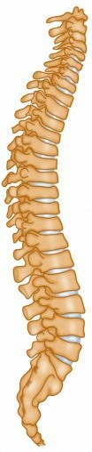
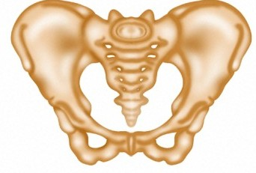
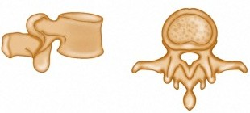
The lumbar vertebrae become robust and the pelvis becomes short and bowl-shaped. Both structure are now load-bearing, carrying the weight of the upper body.
Lumbar curve
Wellcome Photo Library

Slide 15
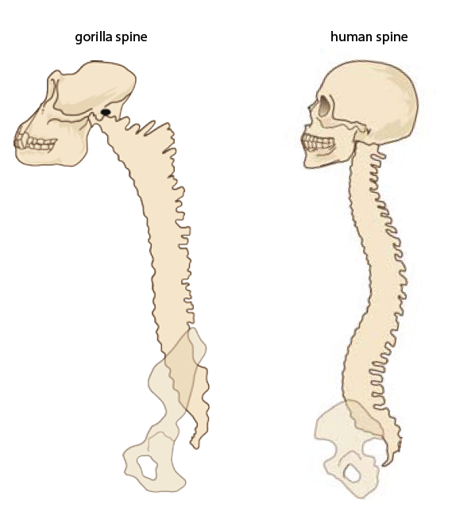
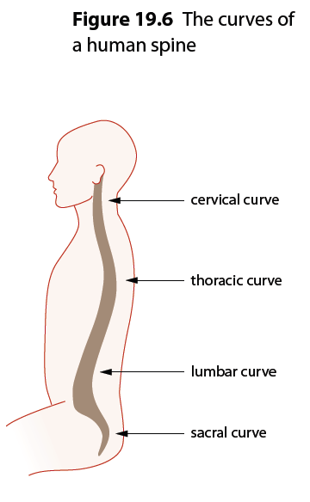
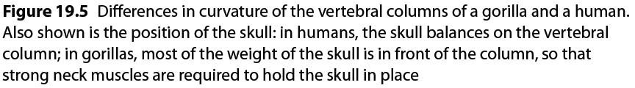

Slide 16
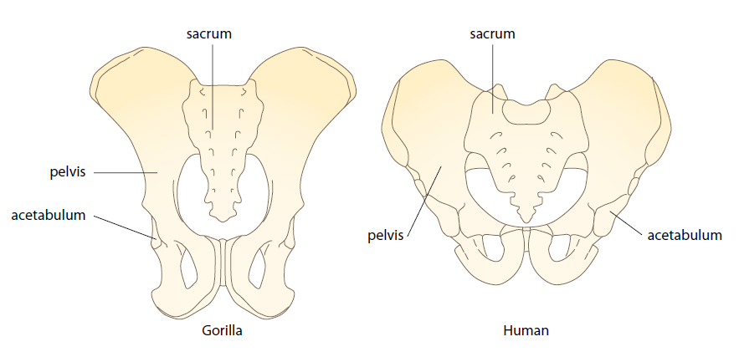
3. The jaw
Apes have a protruding (prognathic) jaw; humans – facial profile is much flatter.
During evolution, the size and protrusion of the human jaw has gradually been reduced – allows the skull to balance on the top of the spine without the need for extra muscle. Weight in front of foramen magnum is approximately equal to weight at the back.
4. The pelvis
At its lower end, the vertebral column articulates with the pelvis – in humans is broader, shorter from top to bottom apes, and bowl-shaped (Fig. 19.7) – supports the abdominal organs during upright stance – in females – supports the developing foetus during pregnancy – female pelvis tends to be slightly broader than male’s to allow the passage of the infant at birth.

Slide 17
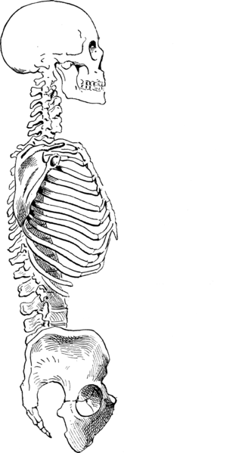
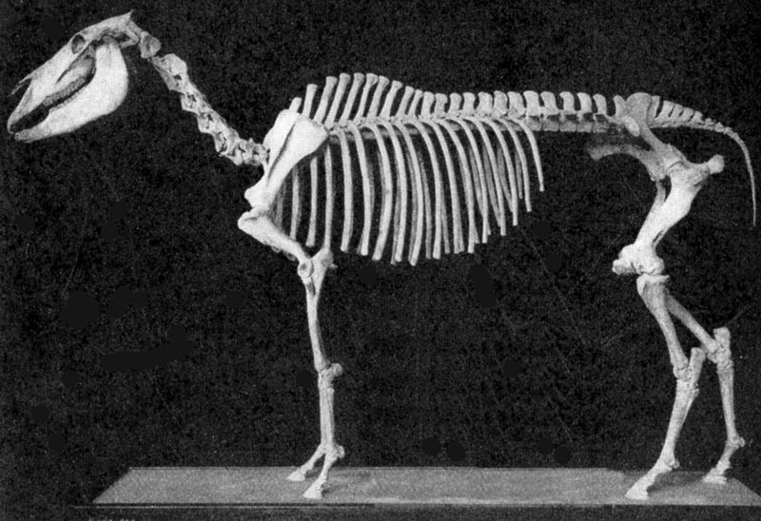
In humans, a pronounced inward curve has developed in the lumbar region of the spine and the pelvis has been tilted into an upright position.
Lumbar curve

Slide 18
The carrying angle
The shape and orientation of the pelvis results in the hip joint being directly under the trunk and head – allows weight of body to be transferred from pelvis to legs. The head of the femur is large and fits into the acetabulum (hip socket). Because the pelvis is broad, hip sockets are wide apart, but femurs tend to converge towards the knees – forms an angle to the vertical, termed the carrying angle (Fig. 19.8) – ensures that weight distribution remains close to central axis of body when walking – allows for greater stability when walking – each footstep follows a more or less straight line – allows for a striding gait instead of swaying from side to side like gorillas or chimpanzees when walking on two legs.
NOTE: One feature not mentioned here is that the acetabulae of gorillas and chimpanzees are directed outwards at right angles to the midline of the body, whereas in humans, the acetabulae are directed outwards and downwards at an angle of about 45⁰ to the midline of the body. This means the head of the femur for gorillas and chimpanzees is inserted at right angles and so the legs are parallel to the midline of the body creating the waddling gait as they walk. In humans, the femurs angle in toward the midline and are so the knees are close to the midline when walking allowing for the striding gait. (See next slide)

Slide 19
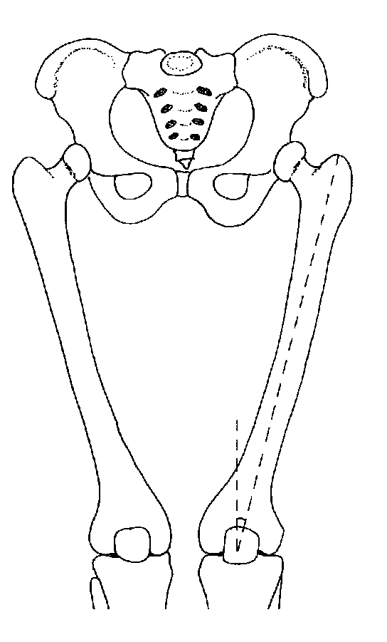
The development of a carrying angle facilitates the striding gait. It also brings the weight of the body onto the outer condyle.

Slide 20
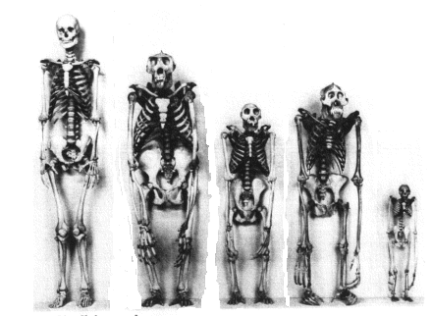
http://www.accuracyingenesis.com/skeleton.gif
The knee
The weight of the body is transmitted down the outside of the femur to the knee –Because weight is transmitted to outer ‘hinge’, it is larger and stronger than inner one (see Fig. 12.13 on page 200) – centre of gravity of body tends to fall through a line just in front of knees – results in a force that tries to bend the knee backward – resisted by the ligaments making up knee joint – produces a joint that requires no energy to support body in a standing position.

Slide 21
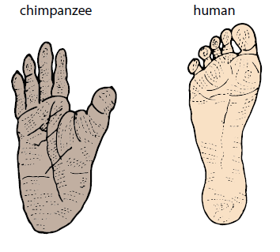
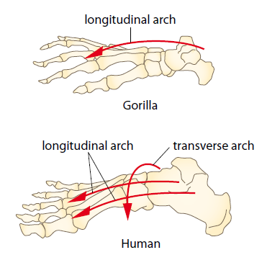
The foot
From knee joint, most of the weight of body transmitted through tibia to ankle, where bodyweight is transmitted through the talus bone to the other tarsal bones, then to metatarsals and phalanges via arches of foot.
Human foot – highly specialised locomotory organ – has lost all of its grasping ability, or prehensility – big toe is short and large – in line with other toes. (c.f. Apes prehensile and opposable big toe). Metatarsals form two arches: a longitudinal arch running from front to back, and a transverse arch running from side to side – transverse arch is unique to humans (Fig. 19.9) - enables humans to walk bipedally (bipedal locomotion) using the striding gait so that the hip and knee are fully extended (see Fig. 19.12).
From Figure 18.4

Slide 22
Table 19.1 A summary of the main adaptations for erect posture
Structure | Adaptation
Foramen magnum | Located centrally in the base of the cranium
Jaw bone | Small and non-protruding so that it enables the skull to balance on the vertebral column
Vertebral column | Lumbar vertebrae wedge-shaped producing an S-shaped curve that brings the vertebral column directly under centre of skull
Pelvis | Broad; shallow from top to bottom. Provides support for abdominal organs. Attachment of femurs wide apart contributing to carrying angle
Femurs | Large head to femur that contributes to the carrying angle
Knee joint | Large head to femur that contributes to the carrying angle
Legs | Longer than arms, contributing to a low centre of gravity. Carrying angle allows the weight of the body to be kept close to the central axis
Foot | Large heel bone and aligned big toe form a pedestal on which the body is supported. Foot has both longitudinal and transverse arches

Slide 23
Stance and locomotion
Homo neanderthalensis (Neanderthal man), Homo erectus and Australopithecus are extinct hominins that we know from fossils. The fossil bones show us that these people could walk upright on two legs (Fig. 19.1, p. 318) and therefore they are classified as hominins.
Please note: There is quite a bit of controversy regarding the bipedality of the Australopithecines – most scientists currently agree that they were probably quadrupedal for most of their existence and only walked bipedally occasionally, similar to modern day chimpanzees. For the purposes of this course, you are required to consider them as bipedal.
One of the essential elements for maintaining an upright stance is muscle tone - partial contraction of skeletal muscles. To keep head erect, muscles in the back of the neck are partially contracted; that is, they have tone. If someone falls asleep while sitting up, the decrease in tone is evident as the head nods until the chin is close to, or resting on, the chest.

Slide 24
In humans, muscles that support the body in an upright position also bring about movement of the spine, hip, knee and ankle, and include the abdominal muscles. The nervous system and a variety of sense organs work together to maintain the tone in these muscles and the equilibrium of the body.
Walking upright so that the hip and knee are fully straightened is referred to as striding gait. In the striding gait, when the foot hits the ground,
Weight is transmitted from the heel along the outside of the foot as far as the ball,
Crosses the ball of the foot (via the transverse arch) and
Is carried to the big toe.
At the final moment of striding, the whole weight of the body is propelled by the big toe.
(Sometimes human locomotion is referred to bipedal plantigrade propulsive striding. What does this mean?)
During striding gait, the arms swing to counteract the rotation of the body through the pelvis.

Slide 25
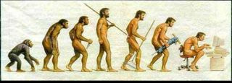
Survival Advantage of Bipedalism:
Hands free for… carrying food, tool use and manufacture, communication, carrying offspring (longer parental care)
Higher reach for collecting food
Improved cooling of body due to decreased SA exposed to sun
Increased range of vision to detect for predators
Increased height to deter predators.

Slide 26
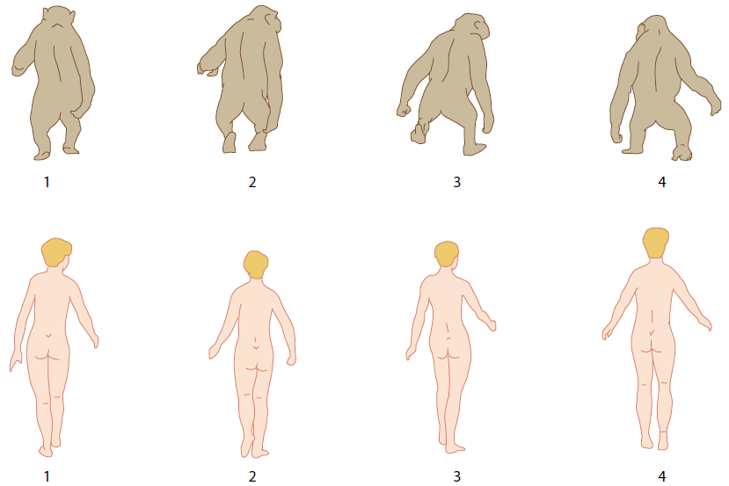
The articulation of human femurs with the pelvis ensures that weight distribution remains close to the central axis of the body during walking – also allows for stability during walking as the body can be rotated about the lower leg and foot, thus allowing each footstep to follow a more or less straight line.
Apes like chimpanzees lack a wide pelvis and carrying angle. When walking on two legs they must sway from side to side so that the body weight is over each leg in turn (Fig. 19.13).

Slide 27
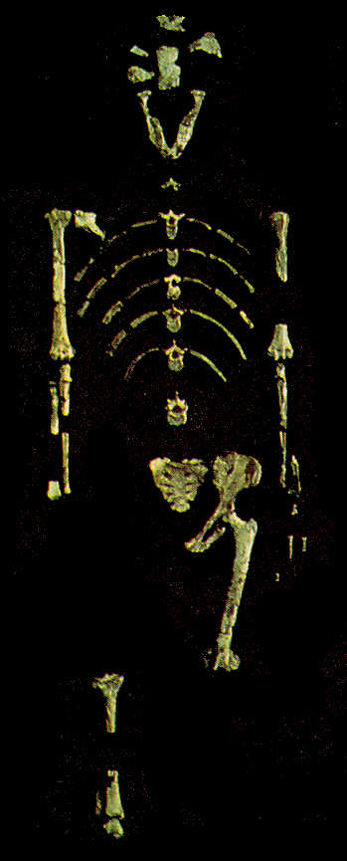
The Laetoli footprints (Fig. 19.1) are evidence that early hominins existed over 3 million years ago*.
Scientists agree that they were made by Australopithecus afarensis 3.56 million years ago.
Footprints indicate a bipedal form of locomotion include a deep impression showing
the heel hitting the ground first,
the lateral transmission of weight from the heel to the ball of the foot,
a well-developed longitudinal arch,
a big toe which was parallel to the other digits, and
a deep impression where the toe pushed the foot forward for the next stride.
*Dated using K-Ar radioisotope dating which used volcanic ash in which the fossils were found to arrive at a date
http://www.ecotao.com/holism/glos/lucy-1.jpg

Slide 28
Relative size of the cerebral cortex
Humans have relatively large brains: range in size from 900 cm³ to 2200 cm³ but average around 1350 cm³ – contrasts markedly with those of the apes, which average between 400 cm³ and 500 cm³. Difference in brain size is associated with the cerebrum. Outer portion of cerebrum is cortex – portion of human brain that shows greatest degree of development. Surface area of cerebral cortex greatly increased by folds, called convolutions – give a surface area 50% greater than a brain that has no convolutions.
Compared with apes, the front part of the cerebrum, known as the frontal lobe, occupies the greatest proportion of surface area. In humans it makes up 47% of the total surface of the cortex, whereas in apes it comprises only 33% - where higher functions of thinking, reasoning, planning and processing take place.
A large brain requires a large brain case, or cranium. So, the brow tends to be vertical and lacks the prominent brow ridges possessed by the apes. These features, together with a shortening of the snout, have given humans a flat face, although the bones of the nose have been left protruding. For this reason humans have a far more prominent nose than any other primate.

Slide 29
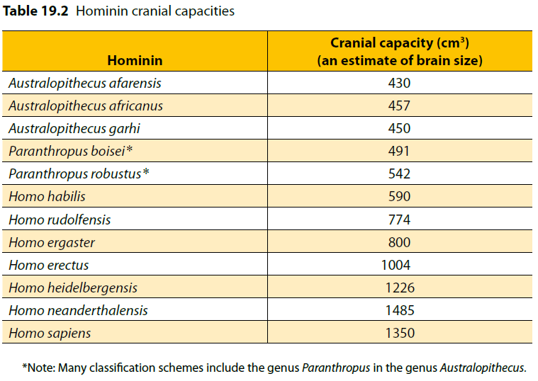
The shape of the brain surface has been determined from endocasts, impressions of the inside of the skull made from rock or some other solid material (e.g. Plaster of Paris can be used to fill cranial cavity of fossil skulls discovered intact) indicated that Australopithecine brains were more human-like than ape-like – foramen magnum was more forward than it is in apes – skull more rounded at the back.

Slide 30
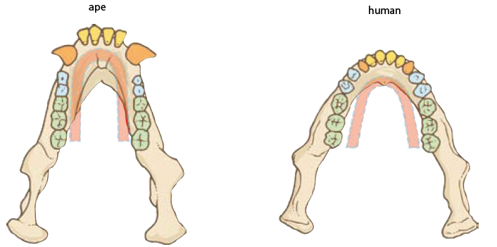

A gradual increase in the number of convolutions and the size of the frontal lobe are also evident.
Over the period of time Homo erectus lived on earth, cranial capacity increased from about 750 cm³ to 1250 cm³. As brain case expanded, face tended to become flatter – a noticeable forehead began to develop in the later members of the species – probably due to an expanding frontal lobe (Fig. 19.16).
Prognathism and dentition
Compared with other primates, human dentition is very distinctive. In humans, canines look more like incisors – they do not protrude and interlock in the upper jaw – small canine teeth and relatively small incisors take up less room in the jaw – shape of the tooth row, or dental arcade, has evolved from the U pattern of the apes to become parabolic in shape, as shown in Figure 19.17.

Slide 31
Early hominins, such as Australopithecus afarensis, had a jaw and face that was more ape-like – teeth were large – possessed a diastema – U-shaped dental arcade. By the time of Homo habilis, molars and premolars had become smaller and narrower – canines were still prominent. The trend continues in H. erectus – teeth of more recent fossils are generally smaller than those of earlier members. The molars, in particular, show a decrease in size over time – may reflect the progressive change in diet to softer foods, including more meat and cooked food in the diet.
The long-term trend towards smaller teeth is also noticeable in modern humans. Humans that lived about 100 000 years ago had teeth that were 10% larger than humans of today. Modern (current day) humans also appear to be gradually losing their wisdom teeth (the third molar), with an increasing number of people having no wisdom teeth at birth.

Slide 32
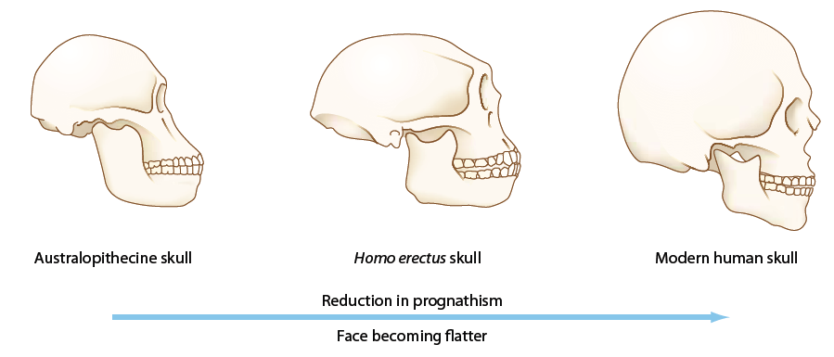

Apes and the early hominins have a forward jutting jaw, a characteristic known as prognathism. Figures 19.19 and 19.20 show that the australopithecine skull has a projecting jaw that makes it appear almost ape-like, while the skull of H. erectus is less prognathic and that of a modern human is the least prognathic of the three.

Slide 33
Prognathism:
Reduction in prognathism → development of a chin and a prominent nose.
↑ cranium size = more distinct forehead and ↓size of brow ridge.

Slide 34
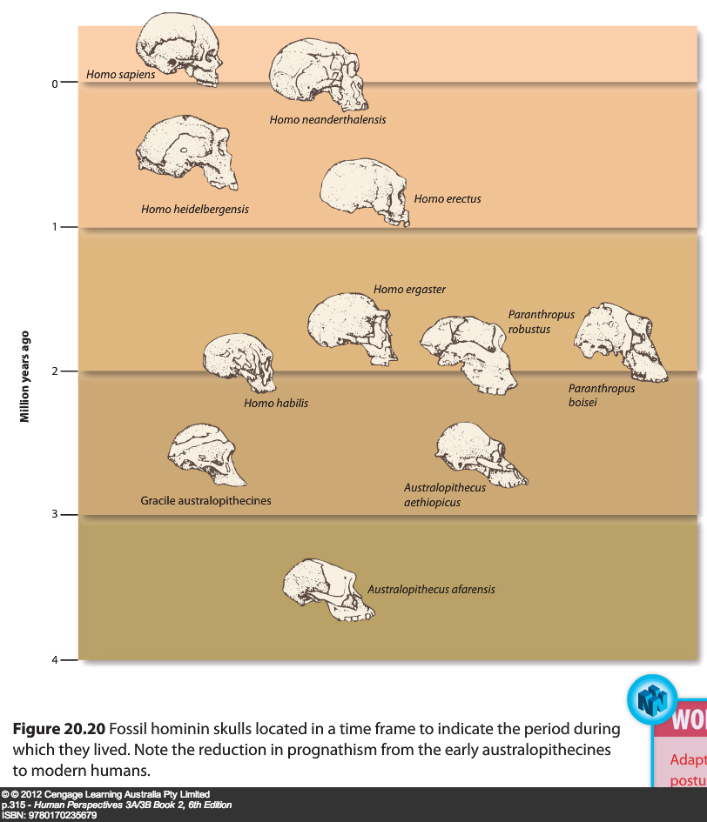

Slide 35
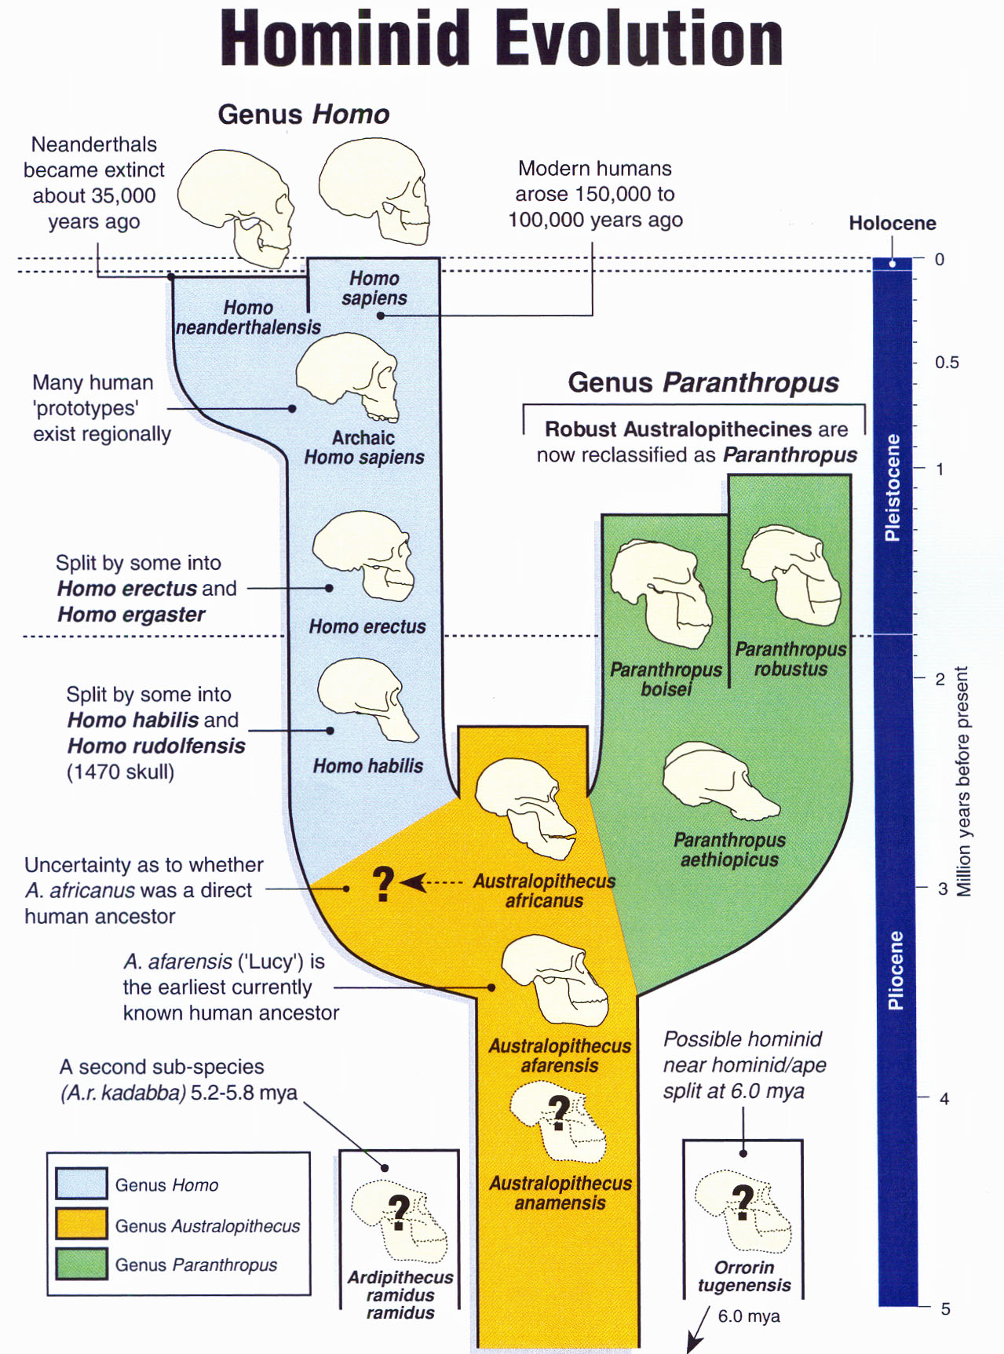
From Biozone OHT Series: Set 8 Human Evolution, Slide 24

Slide 36
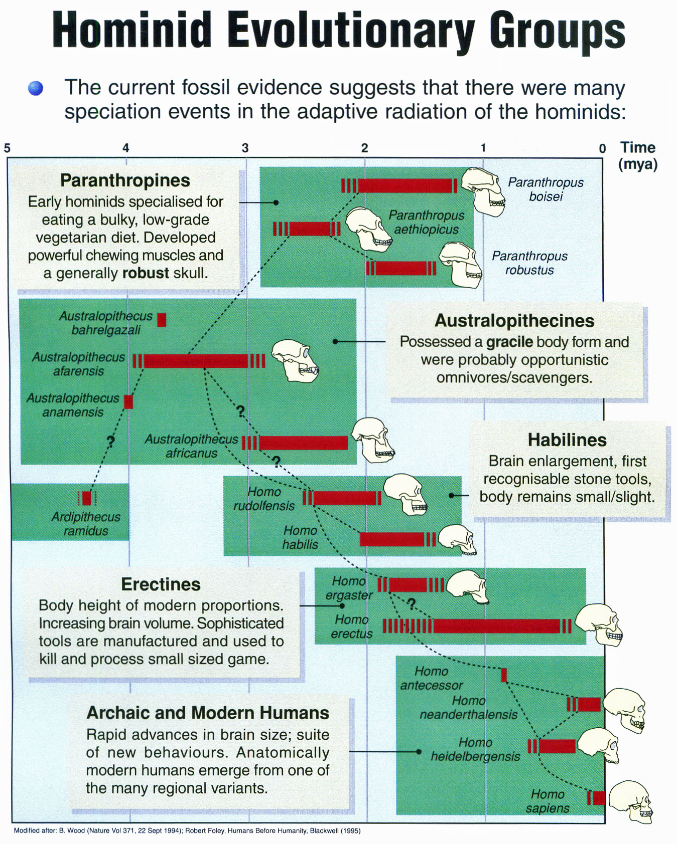
From Biozone OHT Series: Set 8 Human Evolution, Slide 25

